Slide 1
Data Processing Pipelines
CS611 – Machine Learning Engineering Assignment 1
Lim Boon Yan Edward
01548108

Slide 2
Assignment Objective
To build an end to end data processing pipeline that transforms raw loan and customer data into ML-ready feature and label stores using the Medallion Architecture.
The pipeline applies data ingestion, cleaning, schema enforcement, feature engineering and modular PySpark processing across bronze, silver and gold layers. It also uses Docker and GitHub to support a more reproducible machine learning engineering workflow.

Slide 3
Medallion Architecture Design
Medallion Layer
Transactional Data
Pipeline Orchestration
LMS Loan Data
Pipeline orchestration:
Initialize Spark
Generate snapshot schedule
Trigger pipeline execution
main.py
Transformation Logic
Features Data
Data Storage Layers
Clickstream
Bronze
(CSV)
Raw snapshot ingestion
Minimal to no transformation
data_processing_bronze_table.py
Raw ingestion
Attributes
Silver
(Parquet)
data_processing_silver_table.py
Schema enforcement
Data cleaning
Standardisation
Cleaned & standardised
Financials
Gold
(Parquet)
data_processing_gold_table.py
ML-ready datasets
Feature engineering
Merging features to Loan Data
Label Generation
Feature store + label store

Slide 4
Bronze Layer Implementation: Raw Data Ingestion
Raw LMS and customer feature datasets are ingested using PySpark filtered by snapshot_date and stored as monthly CSV partitions in the bronze datamart. Minimal transformation is applied to preserve source data integrity and maintain traceability for downstream silver and gold processing.
Input Sources
lms_loan_daily.csv feature_clickstream.csv features_attributes.csv features_financials.csv
Implementation Steps
Read raw CSV files using PySpark. Filter records by monthly snapshot_date. Save each monthly snapshot as a separate bronze file. Store outputs under the bronze datamart folders.
Output Tables
bronze_loan_daily_YYYY_MM_DD.csv bronze_clickstream_YYYY_MM_DD.csv bronze_attributes_YYYY_MM_DD.csv bronze_financials_YYYY_MM_DD.csv
Design Rationale
Preserves raw source data for traceability. Keeps bronze layer close to the original source. Enables repeatable monthly backfill processing. Foundation for downstream silver processing.

Slide 5
Silver Layer Implementation: Cleaning and Standardisation
The silver layer reads bronze monthly snapshots, enforces schema, removes duplicates, cleans invalid numeric values, converts date fields and derives repayment indicators such as mob and dpd.
The cleaned outputs are stored as Parquet files and used as the foundation for gold-level feature and label generation.
Input Sources
bronze_loan_daily_YYYY_MM_DD.csv bronze_clickstream_YYYY_MM_DD.csv bronze_attributes_YYYY_MM_DD.csv bronze_financials_YYYY_MM_DD.csv
Key Processing Steps
Load monthly bronze loan and feature files. Enforce column data types. Remove duplicate feature records. Clean invalid characters such as _ in numeric fields. Convert snapshot_date into date format. Create loan repayment features* such as: dpd, mob installments_missed, first_missed_date
Output Tables
silver_loan_daily_YYYY_MM_DD.parquet silver_clickstream_YYYY_MM_DD.parquet silver_attributes_YYYY_MM_DD.parquet silver_financials_YYYY_MM_DD.parquet
Design Rationale
Improves data quality before feature engineering. Standardises schema for downstream joins. Converts raw CSV data into Parquet for scalable storage and analytics. Creates reliable intermediate tables for gold feature and label stores.
features* are further elaborated in slide 7

Slide 6
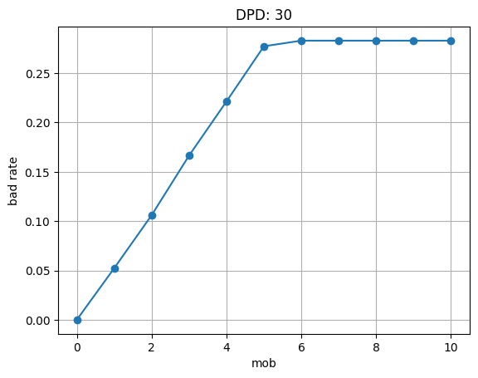
Gold Layer Implementation
The gold layer converts cleaned silver tables into final ML-ready outputs. It creates a default label based on 30dpd_6mob, joins customer feature datasets, engineers financial risk indicators, and stores the final feature and label stores as Parquet files for future model training.
Label store and feature store are stored separately to support reusable training pipelines.
Input Sources
silver_loan_daily_YYYY_MM_DD.parquet silver_clickstream_YYYY_MM_DD.parquet silver_attributes_YYYY_MM_DD.parquet silver_financials_YYYY_MM_DD.parquet
Key Processing Steps
Load cleaned silver loan and feature tables. Generate default labels from loan repayment behaviour. Filter loans at mob = 6. Assign default label using dpd >= 30. Join attributes, financials, and clickstream features by Customer_ID and snapshot_date. Create engineered features*: debt_to_income_ratio, emi_to_salary_ratio, high_credit_utilization_flag
Output Tables
gold_label_store_YYYY_MM_DD.parquet gold_feature_store_YYYY_MM_DD.parquet
Design Rationale
The gold layer separates labels and features into reusable ML-ready stores. This supports future model training while keeping feature engineering and label generation traceable within the Medallion Architecture.
features* are further elaborated in slide 7

Slide 7
Feature Engineering & Label Design
Layer | Feature/ Label | Formula/ Logic | Business Meaning
Silver | dpd | Days between snapshot date and first missed payment | Measures delinquency severity
 | mob | Instalment number | Loan repayment progression
 | installments_missed | Ceiling of Overdue_amt/ due_amnt | Rounded up number of missed installment
 | first_missed_date | snapshot_date – installments_missed | Capture the 1st time period where the payment was due
Gold | label | dpd >= 30 at mob = 6 | Binary loan default prediction target
 | debt_to_income_ratio | Outstanding Debt / Annual Income | Debt burden risk
 | emi_to_salary_ratio | EMI / Monthly Salary | Repayment affordability
 | high_credit_utilization_flag | Utilization > 50% | Indicator of high credit usage risk

Slide 8
Data Quality & Validation Checks
Duplicate Checks | Duplicate records were removed from feature datasets using dropDuplicates() before downstream joins and feature engineering. Validation Logic Checked duplicate Customer_ID and snapshot_date combinations. Prevented duplicate customer feature records in the gold feature store.
Schema enforcement | Column data types were explicitly enforced using PySpark casting to standardise loan and feature datasets.
Invalid Value Cleaning | Removed _ characters from numeric financial columns. Converted cleaned values into numeric datatypes. Age values < 0 or > 100 were treated as invalid and replaced with NULL.
Derived Repayment Validation | Repayment behaviour features were engineered and validated using loan overdue information. mob installments_missed first_missed_date dpd

Slide 9
ML Compataility and Leakage Control
ML Compatibility | Leakage Control
Gold feature and label stores are structured for downstream model training. Features and labels are separated into reusable datasets. Parquet format improves scalability and analytical efficiency. | Labels are generated using repayment behaviour at mob = 6. Feature joins use historical customer information available at snapshot time. Raw future repayment outcomes are excluded from feature engineering.

Slide 10
Limitations and Improvements
Current Limitations
Pipeline currently runs locally using local[*] Spark mode. Batch processing only; no real-time streaming ingestion. Train, validation, test, and OOT data split are not yet implemented. Feature store metadata cataloging is not implemented. No workflow orchestration tool such as Airflow is used yet. No automated model monitoring or retraining pipeline.
Future Improvements
Deploy pipeline on distributed cloud infrastructure. Integrate Airflow for automated scheduling and orchestration. Add train, validation, test, and OOT dataset generation. Introduce online feature store for real-time inference. Add model monitoring and data drift detection. Implement CI/CD pipeline and container registry deployment.

